Slide 1

Content and Collaborative based Sinhala Book Recommendation System
Chinthaka Perera
19440677 / 2019/MCS/067
Supervised by:
Prof. M.G.N.A.S. Fernando

Slide 2

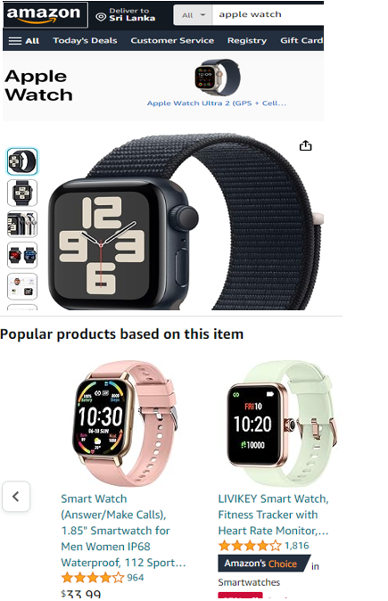

Recommendation systems
A recommendation system is a computer program that recommends items for users of digital platforms such as e-commerce websites and social networks

Slide 3
Types of Recommendation systems
Collaboration Filter
Content Based Filter
Knowledge based
Demographic based
Utility based
Hybrid Filter

Slide 4








Problem statement

Slide 5
Research gap
Multiple application for English Book Recommendation
Online book store limitations

Slide 6
Scope of the study
Share a Google form
Apply sentiment analysis for the reviews
Login and register to the application
Display a book details when a book is selected
List out recommended book list for the selected book
Recommend books from a selected book list.

Slide 7
Literature works

Slide 8
architecture

Slide 9
challenges
To collect a data set
Implementation
Evaluation

Slide 10
demo

Slide 11
limitations
The books published after 2022 were considered.
Age range has not been considered for recommendation.

Slide 12
Evaluation

Slide 13
Future enhancement
Collect more data to enhance the accuracy.
Display the dropdown book list in Sinhala fonts in data collection form.
Consider latest books.
Include a book purchase facility by routing to an online book store.
Include more filters like genre
Include more details of a book like number of pages, published year, ISBM number

Slide 14
Thank you

